Slide 1


SMART INDIA HACKATHON 2024
TITLE PAGE
Problem Statement ID – SIH1640
Problem Statement Title– Assure Contract
Farming System for Stable Market Access
Theme- Agriculture, Food Tech & Rural
Development
PS Category- Software
Team ID- 19748
Team Name – 4625Farmers

Slide 2
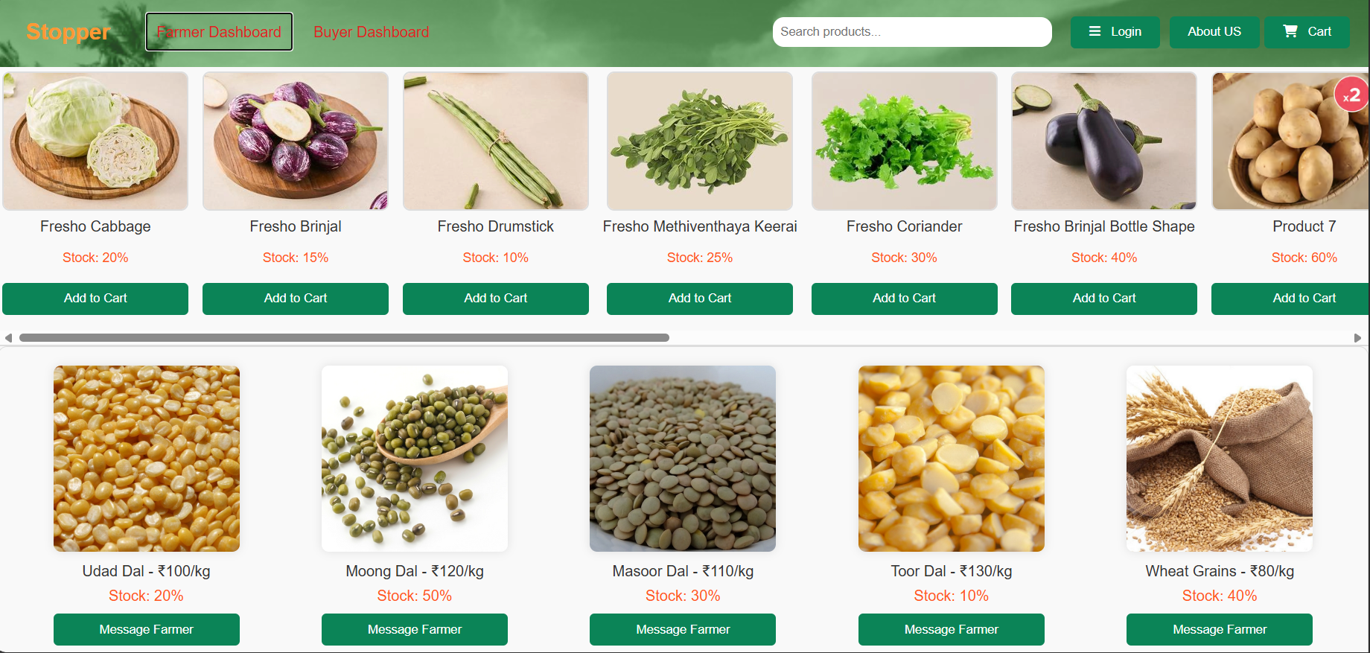
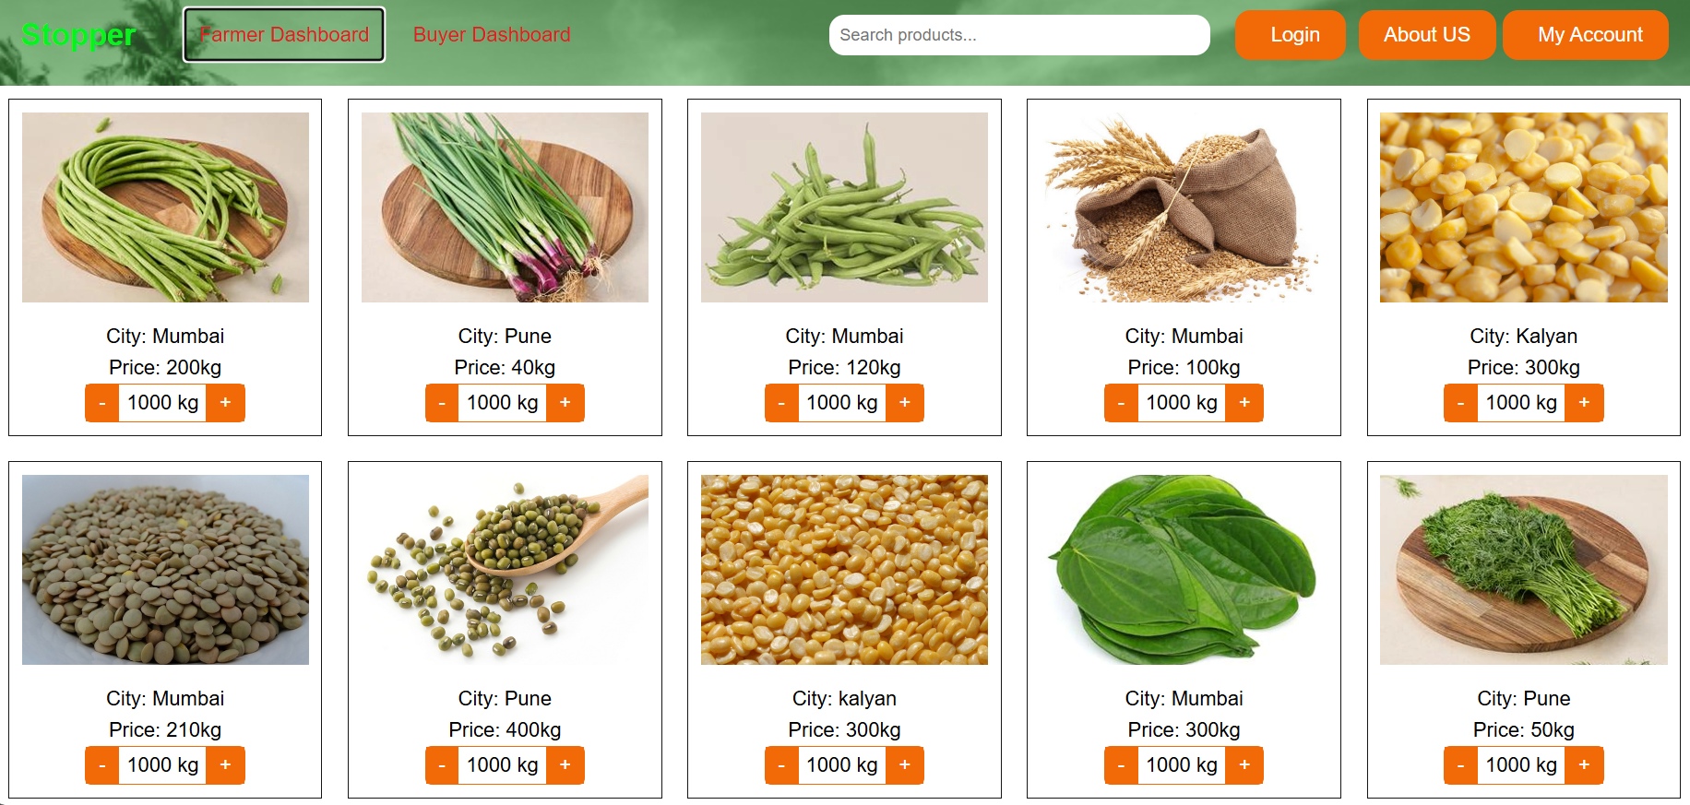
IDEA TITLE:- Stopper
4625Farmers
Problem:
As we know in India, Farmers frequently protest due to unfair pricing and lack of market access Insufficient income. also customer struggles to get fresh, hygienic food daily. Because of this Lots of problems are created Suicide, Food crises etc..
Solution:
Stopper is an Platform connects farmers directly with buyers.
Ensures farmers receive full income at a fixed price.
Eliminates the middleman.
Reduces waste and overproduction .
Buyers receive fresh, hygienic food daily.
Guaranteed buyers ,Secured payment.
Key Features/Innovations/uniqueness :
Monthly Data Collection from Buyer:
City-Based Supply:
Continuous Help Support:.
Crisis Alerts Using Weather Prediction:
ML Model for Crop Suggestions:
Efficient demand and supply chain:
Efficient Delivery System:
Secured Payment:

Slide 3
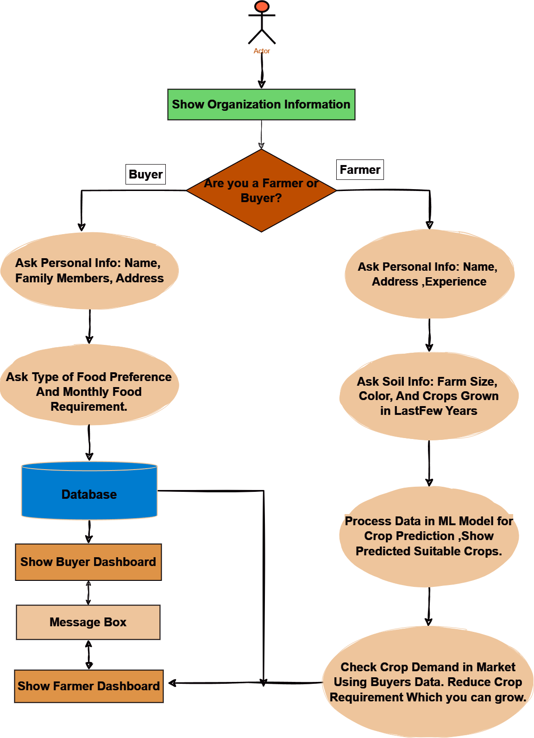










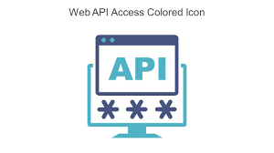
TECHNICAL APPROACH
4625Farmers
Process Flow :-
Technology Stack:-
Product Status:
The product is 60% finished, and we are studying the market by looking at research papers and talking to experts.
Prototype : https://nikhild1111.github.io/4625Farmers/

Slide 4
FEASIBILITY AND VIABILITY
4625Farmers
Feasibility :-
Existing Systems : Existing systems are B2B, involve middlemen, and purchase food in bulk amount when prices are lowest. Then they frozen food and sold it at max prices. so farmers and buyers does not get benefits from it .
Profitability : By cutting middlemen, farmers earn more income and buyers get fresh food at a lower cost daily .
Demand-Driven Farming : We collect Data from Buyer on city basis then Suggest Farmer Which & How Many food has to grow. So preventing waste and reducing overproduction. supply matches demand & demand supply chain created.
Target Audience Reach : Unlike current systems focus only on a 5% People. We provide Secured Message System Between farmer and buyer, so rural areas and middle-class families connects. it help them to grow with the world.
Transportation Cost : We are developing a city-based supply model, which reduces transportation costs, leading to a lower product cost for buyers. Also Alerts and ML models increase feasibility.
Risks/Problems :- Educating farmers on technology, data and payment security, natural crises affecting crops, data accuracy for ML models, delivering food on time, fluctuating food prices.
Risks/Solutions:
Educating Farmers on Technology: Ensure easy-to-use platform ,proper training so farmers can effectively use technology.
Data Security: Implement strong security measure for payment, analyses farmers & buyers data & send alert on problem.
Natural Crises Alerts : Use AI/ML to predict and alert farmers about natural crises to prepare and respond effectively.
Data Accuracy for ML Models : Maintain and update data regularly, with agricultural experts to improve model accuracy.
Delivery System : Develop a timely and efficient delivery system that also creates job opportunities for People.

Slide 5
IMPACT AND BENEFITS
4625Farmers
Government Impact: The platform helps reduce farmer protests by ensuring fair prices. For buyers, it provides fresh, affordable food, which supports government goals for food security and stable markets.
Potential Impact on the Target Audience:
Farmers : They Gain direct access to buyers, so increasing their income , reducing dependence on middlemen, get suggestion for a crops so they can produce crops effectively and also alerts natural crises so they respond effectively.
Buyers : Access the fresh, hygienic product at stable prices, with more transparency and clarity.
Rural and Middle-Class Communities : The main focused is on rural and Middle-Class families so they are aware about the technology and grow with the world. contributing both environment and India's development. As there are many technology present in a market but they don’t connect the rural areas with them so they does not get benefits we are doing this.
Government Impact : The platform helps Government reduce farmer protests by ensuring fair prices. For buyers, it provides fresh, affordable food, which supports government goals for food security and stable markets.
Benefits:
Awareness in rural areas: Helps rural and middle-class families to grow with technology and improve their lives.
Increased income for farmers: Direct market access boosts farmers' earnings and reduces financial stress.
Better food for buyers: buyers get fresh, healthy food, so it reducing healthcare issues .
Stop of farmer suicides: Farmers earn a fair income now , reducing financial burdens so now the suicides are stopped.
Environmental benefits: Reduces overproduction and waste, promoting organic farming and sustainability.
Reduced protests: a fair income is for farmers, so the less dissatisfaction are there so no protests against the government.
Boost to GDP: When our needs are met, we can export the food , contributing to national economic growth.
Best Crop production: ML Model helps farmer to Produce best and More food Product.
Crisis Alerts & Notification: Instant alerts for natural crises or unexpected events for both farmers and buyers.

Slide 6
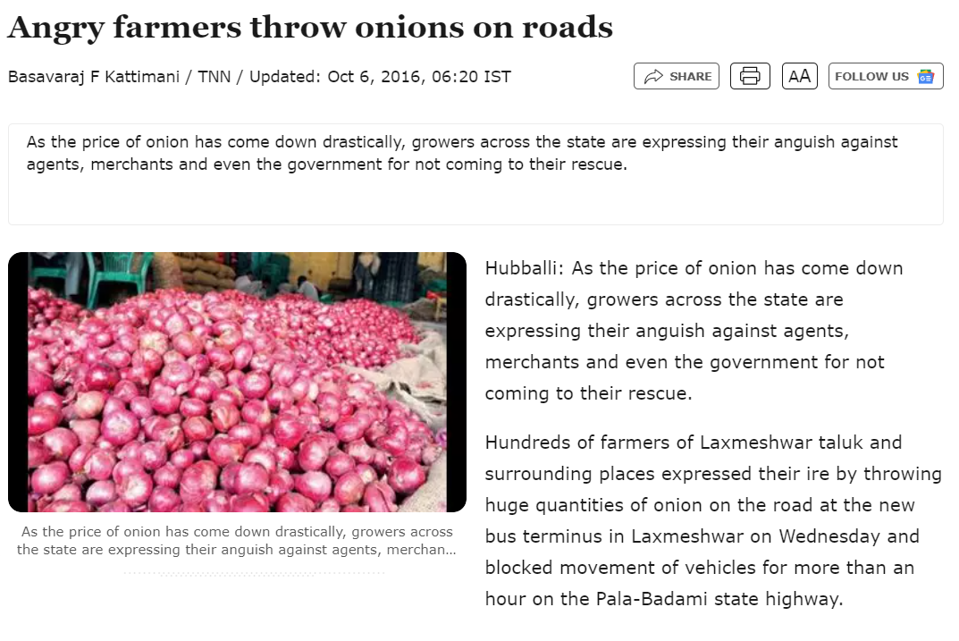
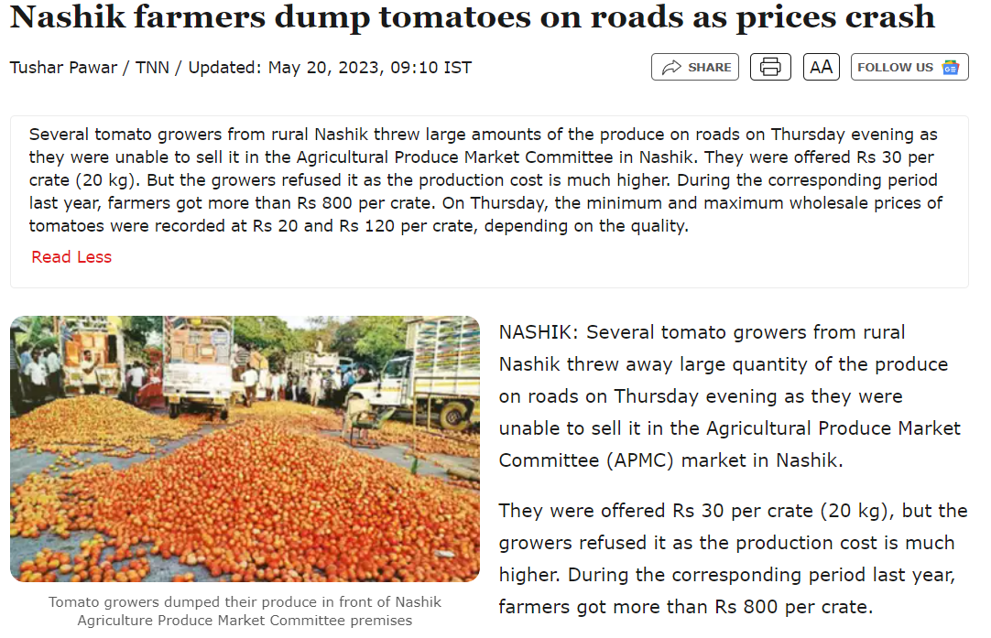
RESEARCH AND REFERENCES
4625Farmers
zzzzzzzzzzzzzzzzzzzzz
Why Contract farming is important . New marketplaces and alternative marketing opportunities.
https://onlinelibrary.wiley.com/doi/epdf/10.1002/cl2.1411
Suggestions to Improve Agricultural Marketing
(PDF) Suggestions to Improve Agricultural Marketing (researchgate.net)
Factors Regarding a contract Farming.
https://www.nature.com/articles/s41598-024-60317-x
Challenges and Solutions in the Agricultural Sector of India
https://www.igi-global.com/chapter/challenges-and-solutions-in-the-agricultural-sector-of-india/337811

